Slide 1

HR DISTRIBUTION
REAGAN JAGG

Slide 2
OBJECTIVE
To analyze employee distribution, movement, experience, and departmental performance using HR data columns such as Employee Status, Movement, Department, Grade, and Total Experience.
To create interactive dashboards for monitoring workforce stability, employee types, marital status, age groups, and reporting structure to support effective HR decision-making.

Slide 3
DATA COLLECTION DATA CLEANING PREPARATION
Short Summary
The HR Distribution dataset was collected from employee records and HR management systems to analyze workforce demographics and employee distribution. The data was cleaned by handling missing values, removing duplicates, correcting inconsistencies, and validating data quality. After preparation, the cleaned dataset was imported into Microsoft Power BI for analysis and visualization, ensuring accurate and reliable HR insights.

Slide 4
DATA ANALYSIS PROCESS
The HR Distribution analysis began with collecting employee data from HR records and systems. The data was cleaned by removing duplicates, handling missing values, and correcting inconsistencies to ensure accuracy. The cleaned data was then analyzed in Microsoft Power BI to examine workforce distribution across departments, locations, age groups, and genders. Visualizations were created to identify patterns and trends, providing valuable insights that support HR planning, workforce management, and informed decision-making.

Slide 5
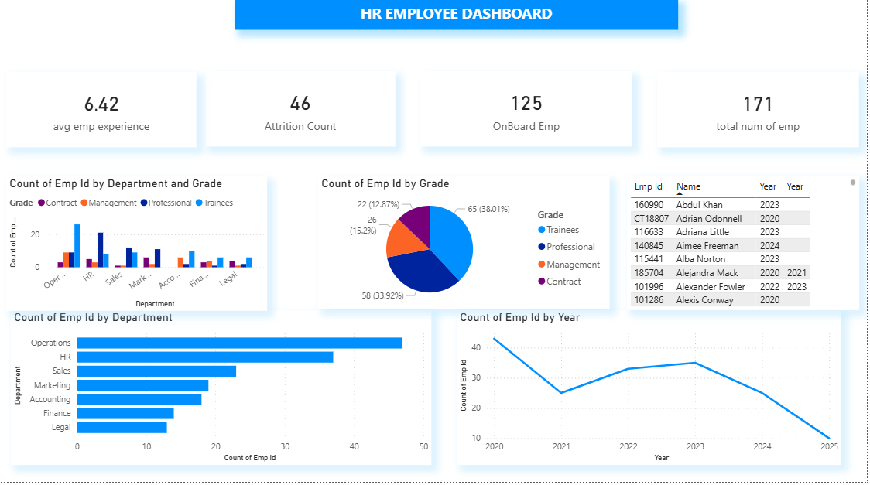
DATA VISUALIZATION

Slide 6
KEY INSIGHT AND FINDING
The HR Distribution analysis showed that employees are primarily concentrated in key departments and fall within the active working-age group. The workforce demonstrates varying distributions across gender and locations, providing insights into organizational diversity and staffing patterns. These findings help support workforce planning, resource allocation, and informed HR decision-making.
6

Slide 7

RECOMMENDATION AND CONCLUSION
Recommendations
Improve workforce planning by balancing employee distribution across departments.
Promote diversity and inclusion initiatives where needed.
Monitor workforce trends regularly to support effective HR decision-making.
Invest in employee development and retention programs.
Conclusion
The HR Distribution project provided a clear understanding of the organization's workforce composition. The insights gained can help improve staffing strategies, resource allocation, and overall human resource management, leading to more informed business decisions.
7

Slide 8

Thank you
REAGAN JAGG
rjeezel35@gmail.com

